Slide 1
© 2018 Cengage Learning®. May not be scanned, copied or duplicated, or posted to a publicly accessible website, in whole or in part.

Slide 2
Brands
7
© 201 Cengage Learning.® May not be scanned, copied or duplicated, or posted to a publicly accessible website, in whole or in part.

Slide 3
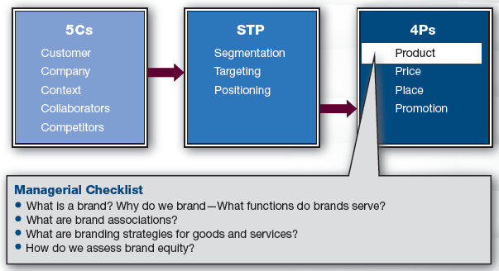
Marketing Framework

Slide 4
What Is a Brand?
Brand
Portfolio of qualities associated with a name
Brands immediately invoke certain images
Brands have value beyond the benefits of the product

Slide 5
Brand Associations
Marketers control some brand associations
Product shape and packaging
Logos, symbols, and colors
Jingles and slogans
Spokespeople
Marketers should control what they can
All outgoing messages should be positive
Marketers do not control all associations
e.g., Personal memories about brands

Slide 6
Brand Name
A brand starts with a name
Some names immediately convey information
e.g., YouTube
Some names suggest their benefits
e.g., Optical4less
Some names are those of their founder
e.g., Christian Dior
Marketer should choose a brand name that conveys its benefits

Slide 7
Brand Names, Logos, and Color
Brand name meaning is built over time through communications with customers
Brand names and logos are a shorthand way to communicate with customers
This is who we are and what we look like
Brand colors and fonts visually engage customers
e.g., The New York Times and Google

Slide 8
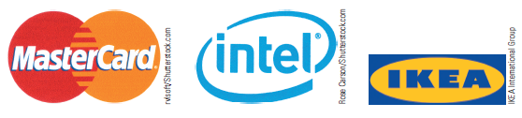
Brand Names and Logos
Some logos combine a brand name with a symbol meant to suggest the brand’s value proposition

Slide 9
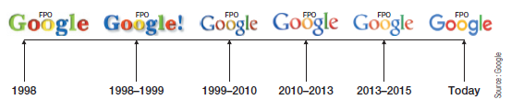
Discussion Questions #1
Should a brand name be adapted over time?
If so, when and why?

Slide 10
Why Brand? (slide 1 of 2)
Customer benefits of branding
Brands identify company ownership
Brands allow for predictable quality
Brands make it easier for customers to make decisions; less perceived risk
Brands serve as status symbols

Slide 11
Why Brand? (slide 2 of 2)
Company benefits of branding
Brands induce loyalty—increasing repeat purchasing
Brands allow premium prices
Brands allow a single firm to pursue multiple market segments

Slide 12
Hierarchy of Brand Associations
Concrete product attributes: 40 mpg
Abstract product benefits: Save money
Abstract emotional benefits: Feel good
Attributes are easy to communicate and easy for competitors to copy
Benefits are abstract; harder to create and communicate, but more meaningful

Slide 13
Brands Serve Social Functions
Brands help customers express their ideal selves
e.g., Certain school, car, and clothing
Brands become the focal point of bonding through brand communities
e.g., Subaru, Harley-Davidson, and Lego

Slide 14
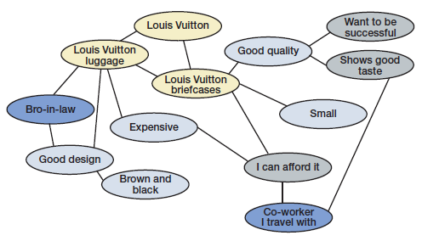
Brand Association Network (slide 1 of 2)
Depiction of brand associations
Unlinked nodes have no or weak connection; strong links are bold

Slide 15
Brand Association Network (slide 2 of 2)
How it works
When brand name is activated, associations are triggered
Nodes closest to the brand are retrieved first
Customer satisfaction with the brand is most heavily influenced by the positivity or negativity of nearest links
Networks may be simple or complex
Depends on focus and consistency of advertising

Slide 16
Discussion Question #2
What comes to mind first when Louis Vuitton is activated?

Slide 17
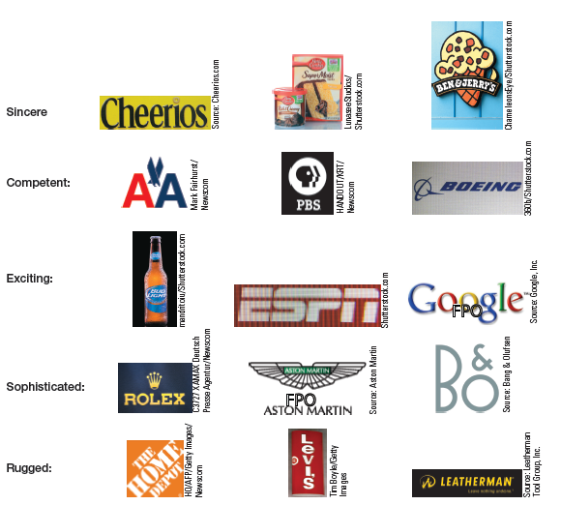
Brand Personalities
Brand can have a distinct personality
Personalities capture
Specific information about the brand
Holistic perceptions about the brand

Slide 18
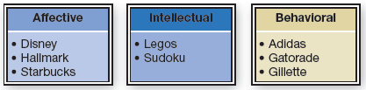
Types of Brand Experiences
Consumers experience brands
Affective (heart), intellectual (mind), and behavior (action)

Slide 19
Brand Communities
Brand communities
Customers who connect with like-minded customers
They have extreme attachments to brands
e.g., Apple, Nintendo, Harley-Davidson
Marketers should try to build and capitalize on these communities

Slide 20
Branding Strategies (slide 1 of 2)
Umbrella approach
Attaching the same brand name to products
Subsequent product introductions are easier for the customer to understand and accept
Higher initial awareness levels
Builds stronger brand associations
Stronger financial outcomes
e.g., Nike, Canon, and GE

Slide 21
Branding Strategies (slide 2 of 2)
House of brands approach
Introducing a new brand name for every product line
Any problems with one brand should not influence the other brands
Brand images do not need to be consistent, which allows for targeting multiple segments
Requires more advertising expense
e.g., Procter & Gamble has 80 major brands

Slide 22
Brand Extensions
Brand extensions
Leverages the brand’s good name to get customers to buy something new
Line extensions
Increase depth—new product within a line
e.g., Cheerios has various flavors
Product category extensions
Increase breadth—new product line
e.g., Amazon sells many different things

Slide 23
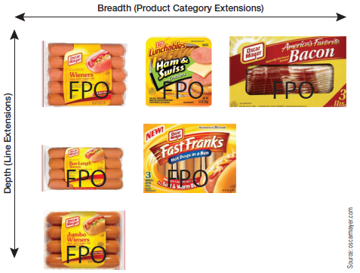
Discussion Questions #3
How might Oscar Meyer extend its line?
How might Oscar Meyer implement a product category extension?
Why would it do either?

Slide 24
Co-branding (slide 1 of 2)
Co-branding
Two companies form a joint venture to create a product from both companies
e.g., Tevlar fabric
Ingredient branding
Form of co-branding in which one company adds value to a host product
One company dominates the other
e.g., Intel in many PCs

Slide 25
Co-branding (slide 2 of 2)
Co-branding works well when a company is introducing a new product attribute
e.g., Adding cough medicine to candy
Self-branding
Branding own ingredient to differentiate its quality from competitors
Works better when tweaking a minor attribute
e.g., Tide’s EverFresh scent

Slide 26
Global Brands
Global brand
30% of revenues from other countries
Global strategies
Glocalization
Different names in different countries
“Manufacturer globally, brand locally”
Global brands
Same brand in all countries
More advantageous
e.g., Amazon.com and Amazon.co.uk

Slide 27
Store Brands
Private label brands
Good for price-sensitive markets
Can be more of a “me-too” product offering
Can be premium private label
e.g., Walmart’s “Sam’s Choice”
Retailer can offer decent quality for lower prices due to reduced advertising costs
Manufacturers are launching second labels to compete with store brands

Slide 28
Brand Equity (slide 1 of 2)
Brand equity
The worth of a brand
Measurement approaches
Determining the price premium of brand
“How much are you willing to pay for gas at Shell?” vs.
“How much are you willing to pay at a local station?”
Comparing branded and unbranded
“How much do you like this $499 Sony flat screen with screen-within-a-screen?” vs.
“How much do you like this $499 unknown brand flat screen sharing the same features?”

Slide 29
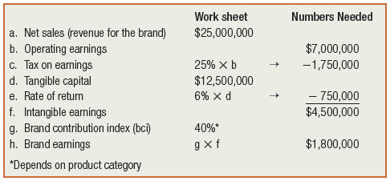
Brand Equity (slide 2 of 2)
Measurement approaches (continued)
Interbrand: assess the value of a firm, subtract its physical and financial assets
Brand contribution index varies by product category: high for cologne, lower for retailers

Slide 30
Discussion Questions #4
What do you think are the top U.S. brands?
What do you think are the top non-U.S. brands?

Slide 31
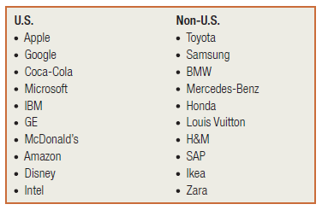
Top Brands

Slide 32
Managerial Recap (slide 1 of 2)
Brands are promises to customers; they include names, logos, colors, and fonts
Brands signal information to customers about predictability
Anticipated reliability and expected quality
Brands can command higher prices because they offset risk

Slide 33
Managerial Recap (slide 2 of 2)
Brand associations are cognitive and emotional
Companies can employ umbrella branding or house of brand strategies
Brand valuation, the measure of the worth of brand, is important to marketers

